Slide 1
Data mining on a Mushroom Dataset
Madhurima Bhattacharyya
Prithi Dominic Savio

Slide 2
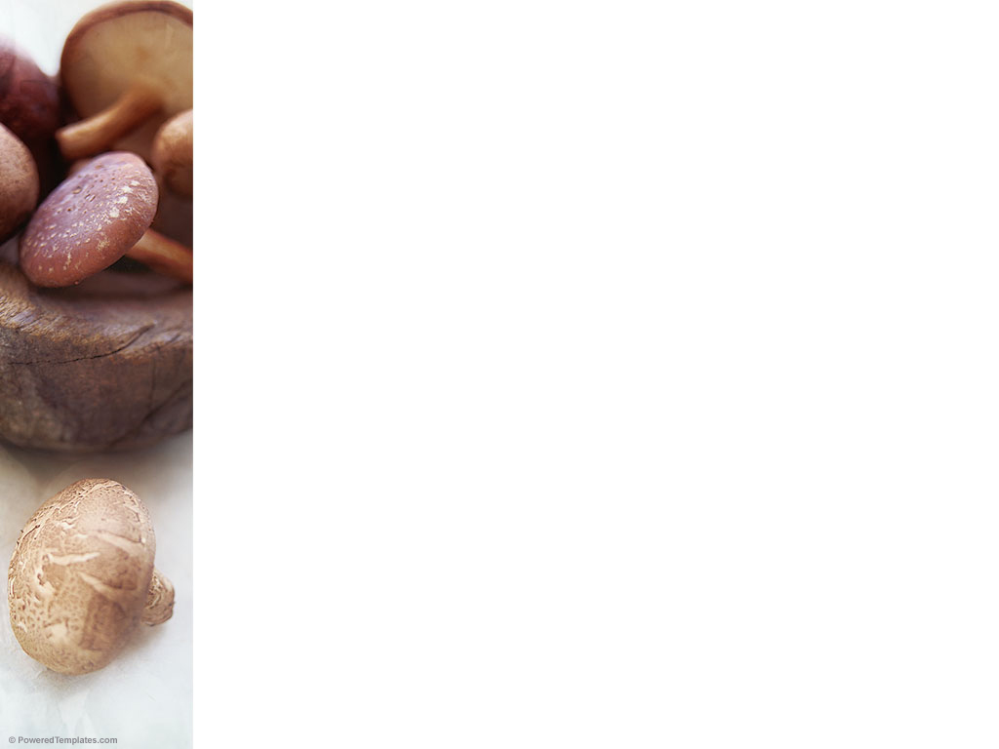
Contents
Introduction
Business Objective
Mushroom Dataset
Exploring Data
Data Visualization
Modeling

Slide 3
Introduction
Company X is mushroom wholesale company
Dealing with large quantity of mushrooms
Being a fungi, it can be poisonous.
Need to separate edible mushrooms from the poisonous ones

Slide 4
Objective
Optimize the process of distinguishing edible mushrooms from the poisonous ones
Cut down the time and resource required to identify mushrooms

Slide 5
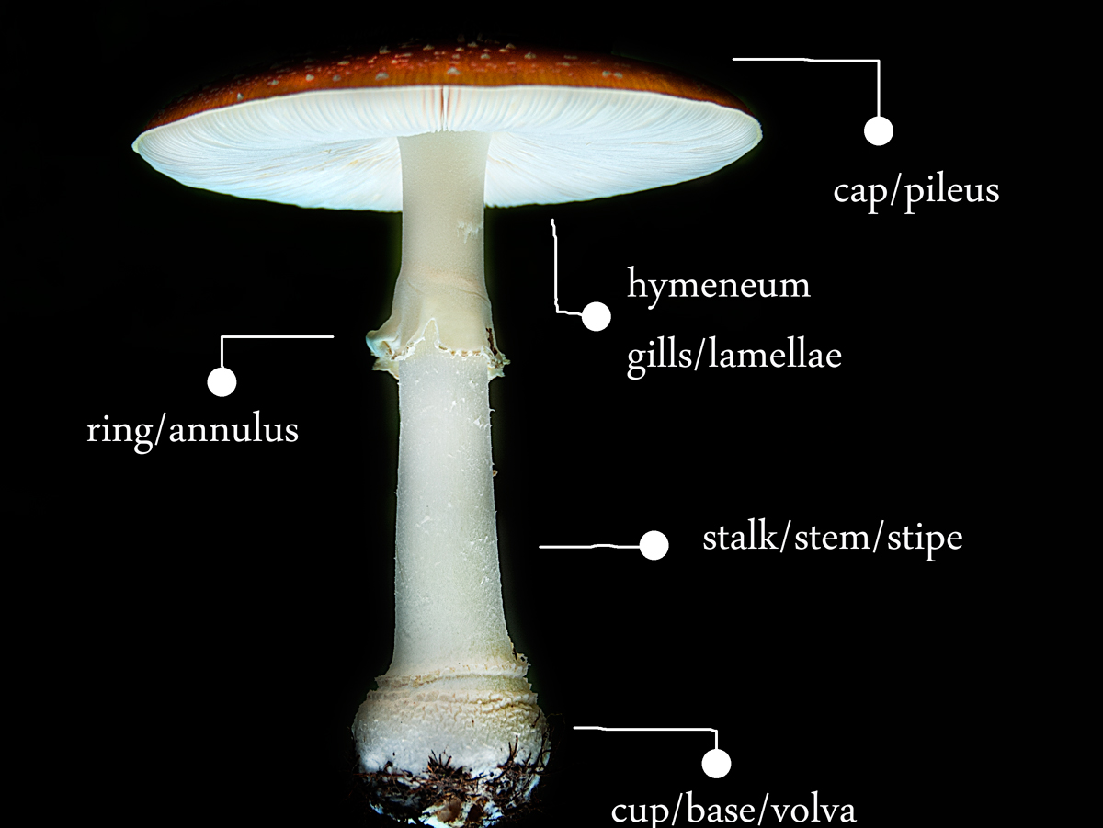
Mushroom Dataset
Response Variable : Class
Edible (e) or poisonous (p)
Predictor Variables : 22 attributes and 8124 rows
18 visual attributes
4 non-visual attributes
Habitat
Population
Bruises
Odor

Slide 6
Exploring Data
Dataset contains only categorical values
For example:
Visual attribute
Attribute stalk-shape has 2 factors; enlarging=e, tapering=t
Non visual attribute
Habitat has 7 factors; grasses=g, leaves=l, meadows=m, paths=p, urban=u, waste=w, woods=d

Slide 7
Exploring Data
Stalk.root had
6 factors: bulbous=b, club=c, cup=u, equal=e, rhizomorphs=z, rooted=r, missing=?
Removed rows having ‘?’
Number of rows reduced from 8124 to 5644

Slide 8
Response variable is Edible or Poisonous Classification method to build models

Slide 9
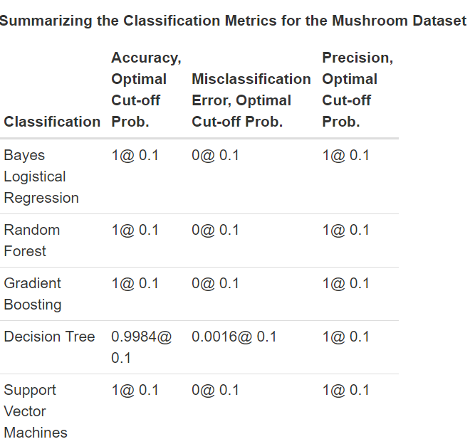
Data Visualization
Prepare bar charts of explanatory variables
Understand whether they are related to an edible mushroom or a poisonous one or both
A variable that has high tendency of being found in both edible and poisonous mushrooms-more than 50%

Slide 10
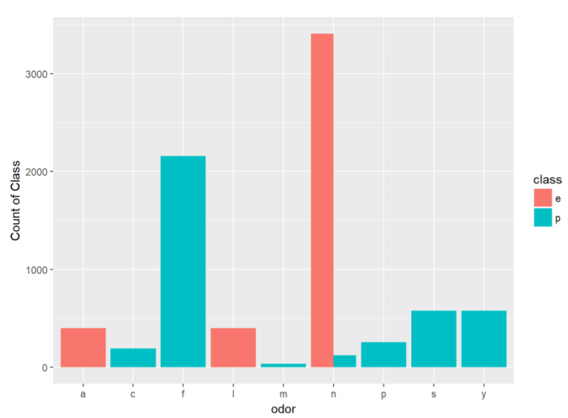
Data Visualization
Odor
Less than 50% cut off

Slide 11
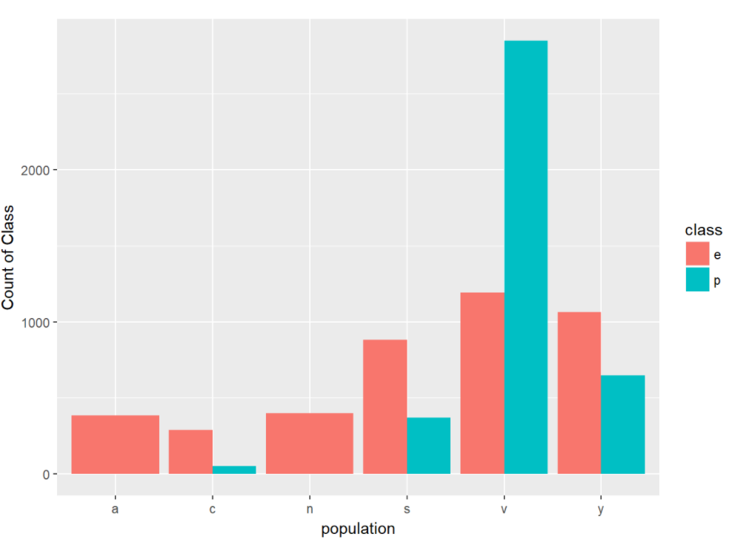
Data Visualization
Population
More than 50% cut off

Slide 12
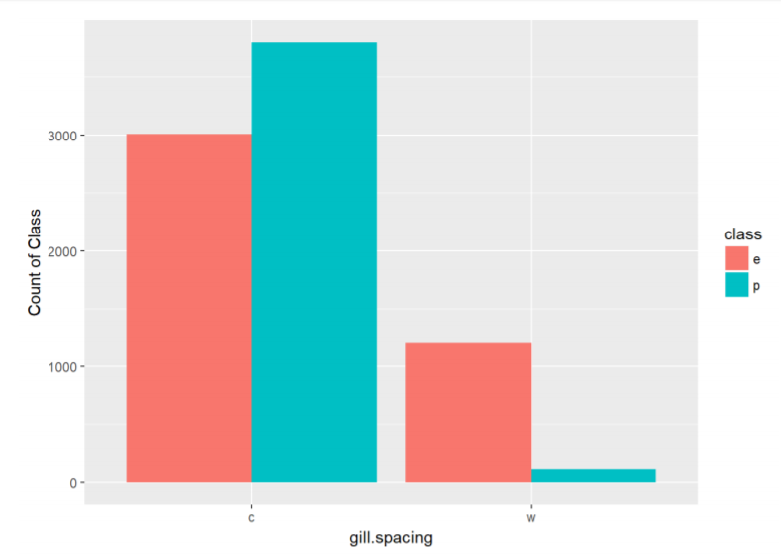
Data Visualization
Gill Spacing
100% cut off

Slide 13
Modeling
Divide dataset intro training and testing dataset
Training dataset has 70% of the data
Testing dataset has 30% of the data

Slide 14
Modeling
The following models were built:
Bayes Logistic Regression
Random Forest
Boosting
Decision Tree
Support Vector Machine

Slide 15
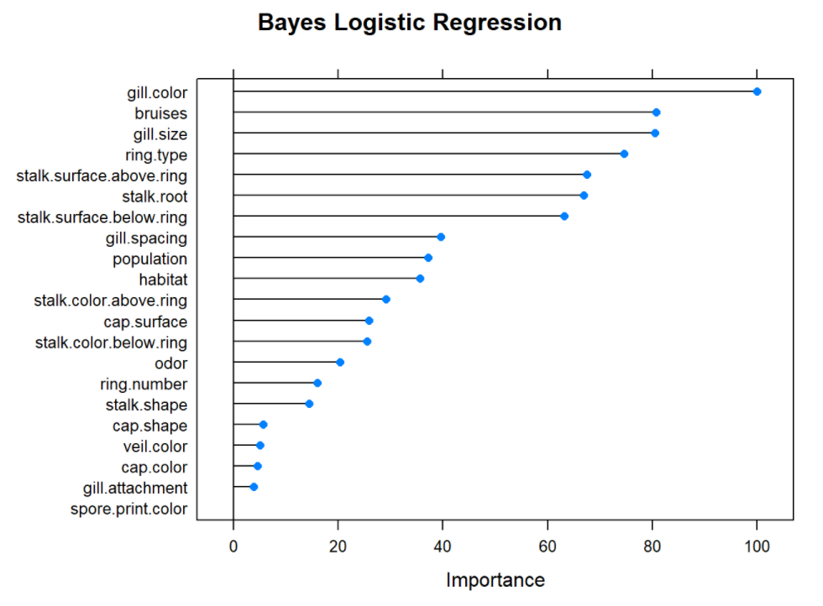
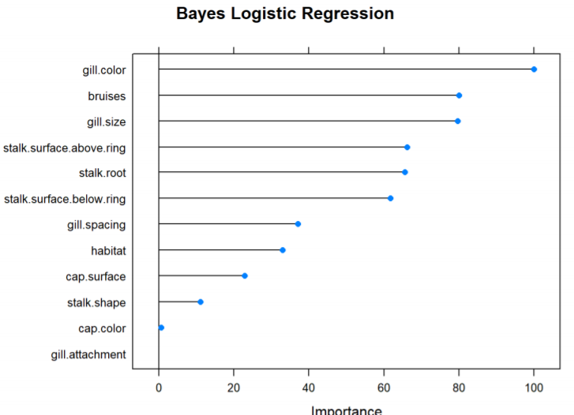
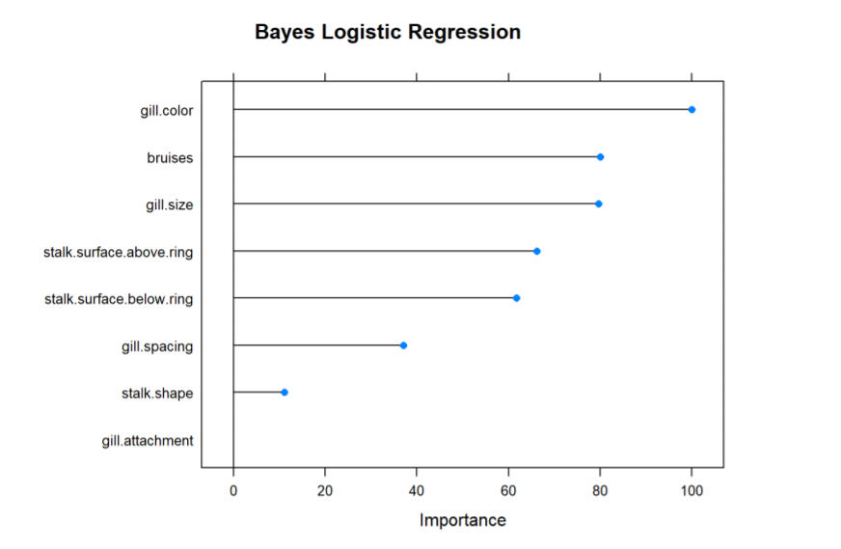
Bayes Logistic Regression

Slide 16
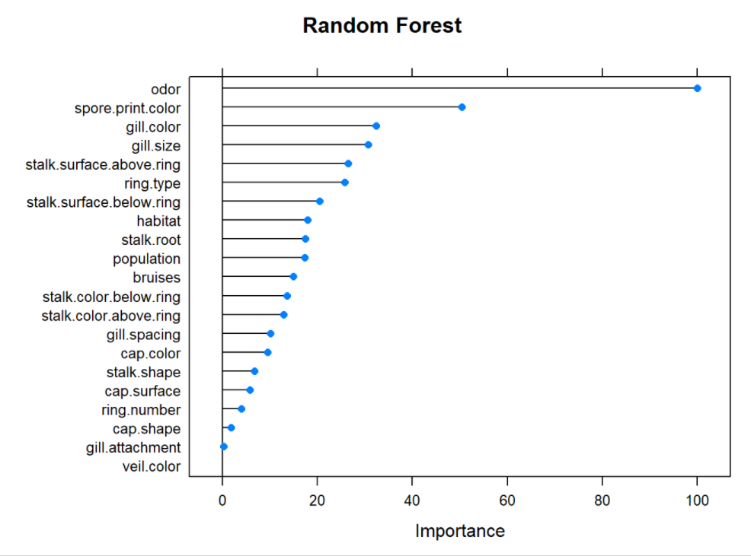
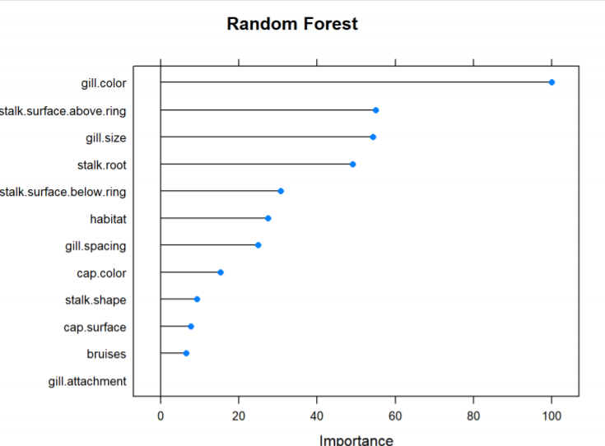
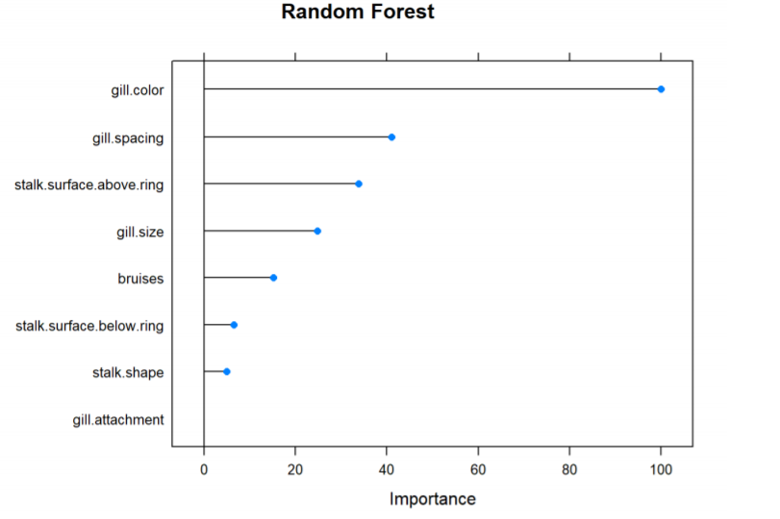
Random Forest Model

Slide 17
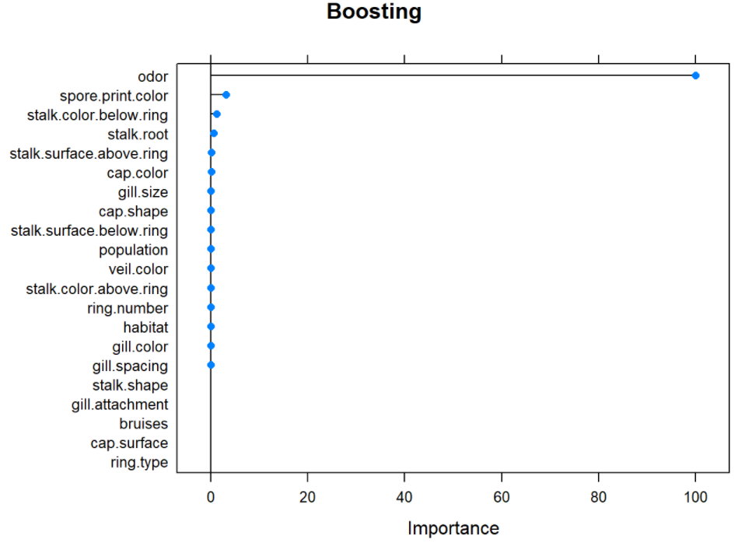
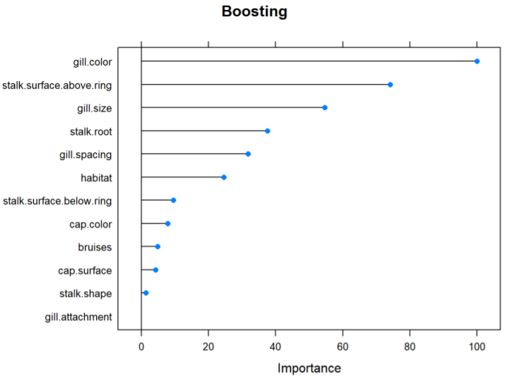
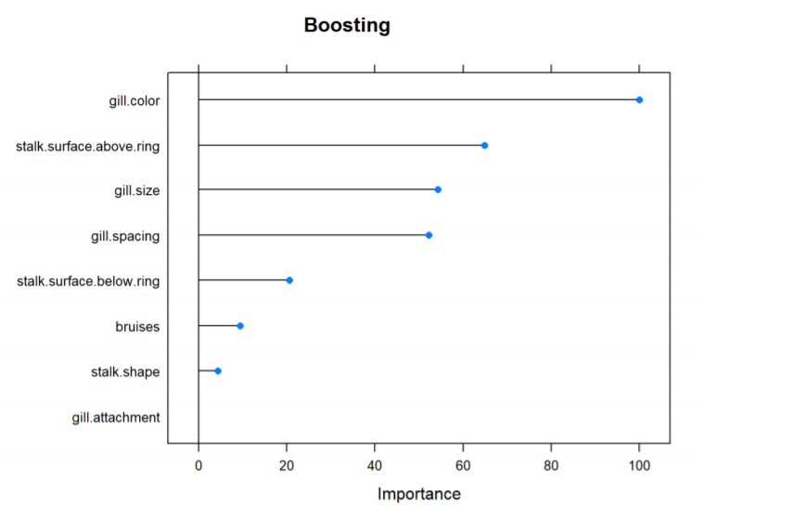
Boosting Model

Slide 18
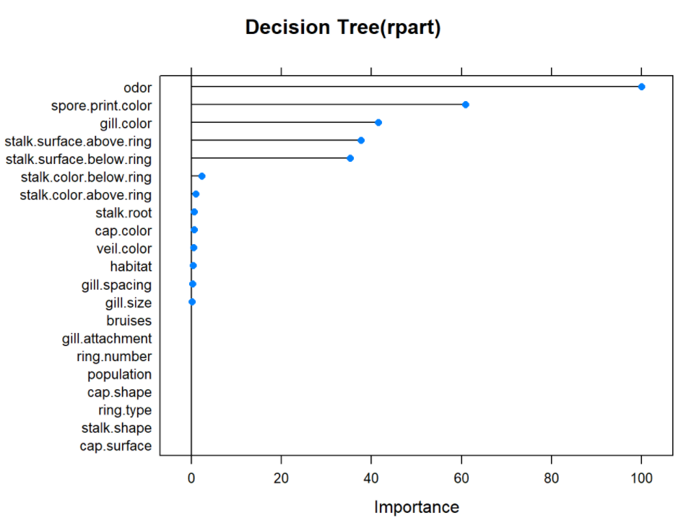
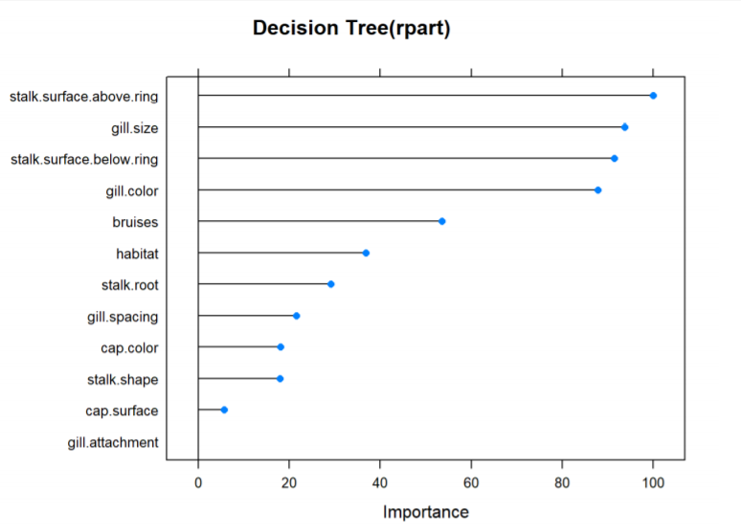
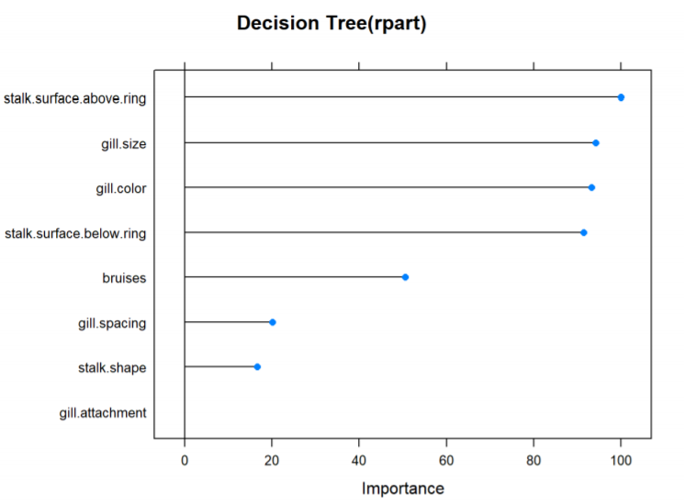
Decision Tree Model

Slide 19
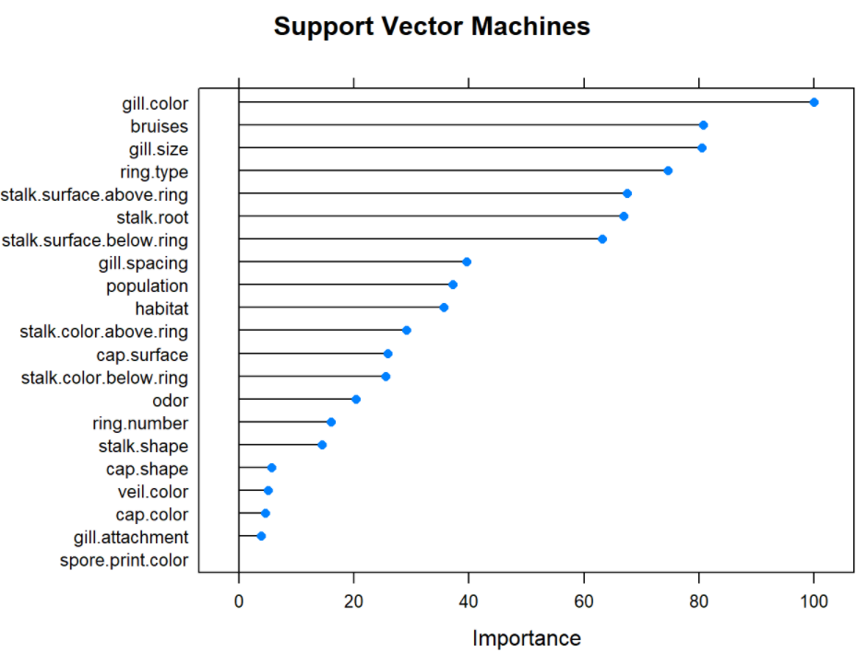
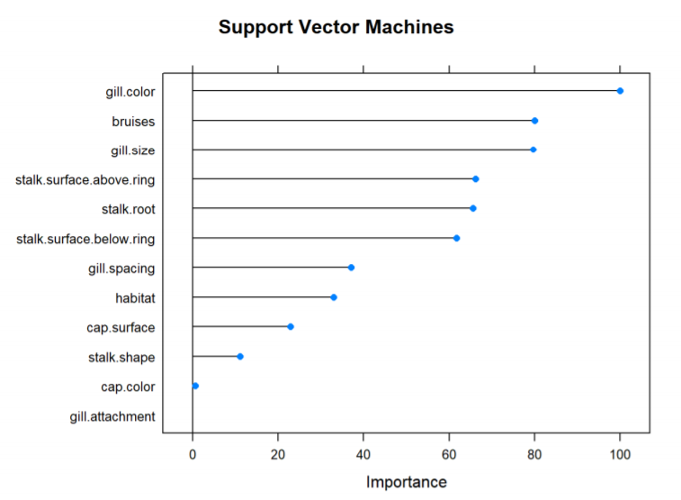
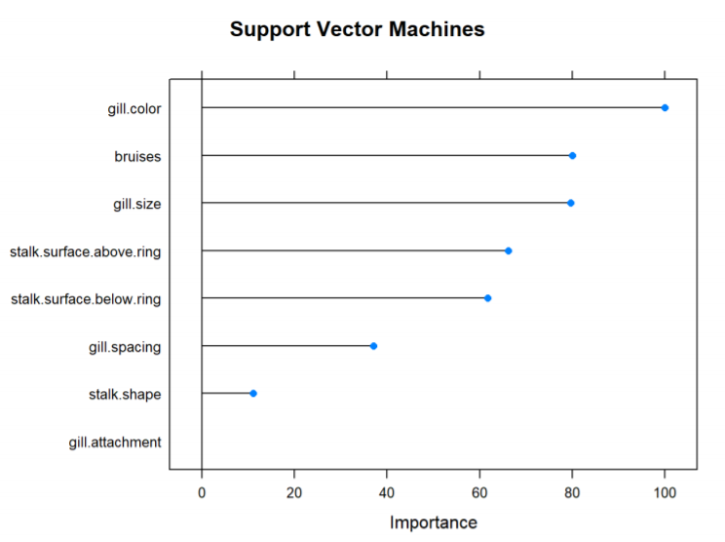
Support Vector Machines

Slide 20
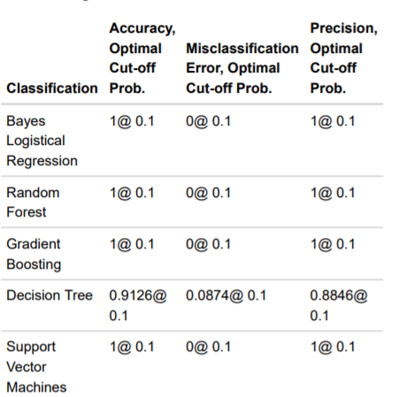
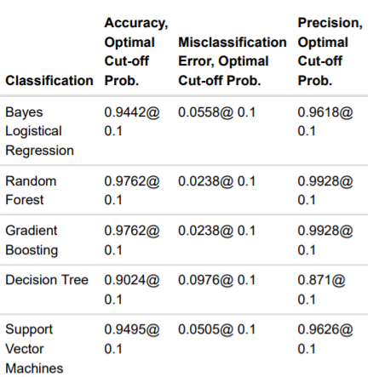
Summarized Metrics for the Mushroom Dataset

Slide 21
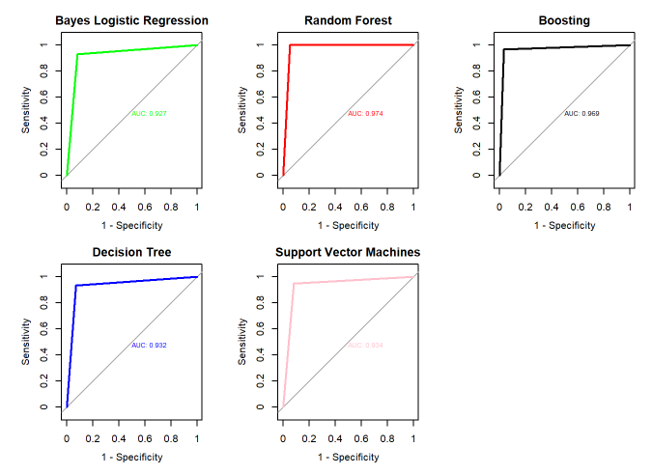
Summarized Metrics for the Mushroom Dataset

Slide 22
Best Model
Our best model is Random Forest
Highest Accuracy
High Value of AUC from the ROC Curve

Slide 23
THANK YOU!

